Slide 2

THE EVOLVING DIGITAL LANDSCAPE
Harnessing 1p Data to Thrive
Notes:
Thank you. What an event! I’m still riding a high from Col. Dan Rooney. The weather, location, food, drinks, music, people. Speaking of people.
My name is Tony Carroll and I work in our Marketing Services Division and I want to just tell a quick story... It’s funny what a small world the Auto industry is, because when I was in retail in the late 90’s early 2000’s, I attended Sales Manager training at a company called “Service Group”. So, to be here today working for iA and speaking to you in this room is pretty remarkable.
So a little about me, Prior to coming on board here at iA I spent 6 years at Google where I served as a founding member of Google’s Automotive Retail team and helped shape the way that Google supported the US dealership network. One of those focus points involved the increase in Online Retail ORT transactions and how dealers will evolve their business to thrive in this new era. One of those tactics is to leverage your own 1P data which is defined as someone who already has an existing business relationship with you, aka they are not a prospect.
So for the next 20 minutes or so I’m going to talk to you about how the landscape is changing and I’m happy to take some questions at the end.

Slide 3




If You Invested Back in 2012…
+924%
+688%
+951%
+1,562%
Notes:
But before we get into my presentation today, I have a fun ice breaker for you. If you could go back in time and invest in these stocks, what % return do you think you would make?
But here’s what may surprise you. Domino’s pizza, which is essentially an OEM franchise model and has remained relatively unchanged in decades, decided to go all in on embracing modern day consumer behavior. Did you know that 75% of their revenue comes from mobile devices? They constantly stay in touch with their customers… from the moment you click on their app, choose toppings, and pay, they are interacting with you, even sending text messages providing updates on driver location.
And why would they do that? Consumer behavior has changed….

Slide 4
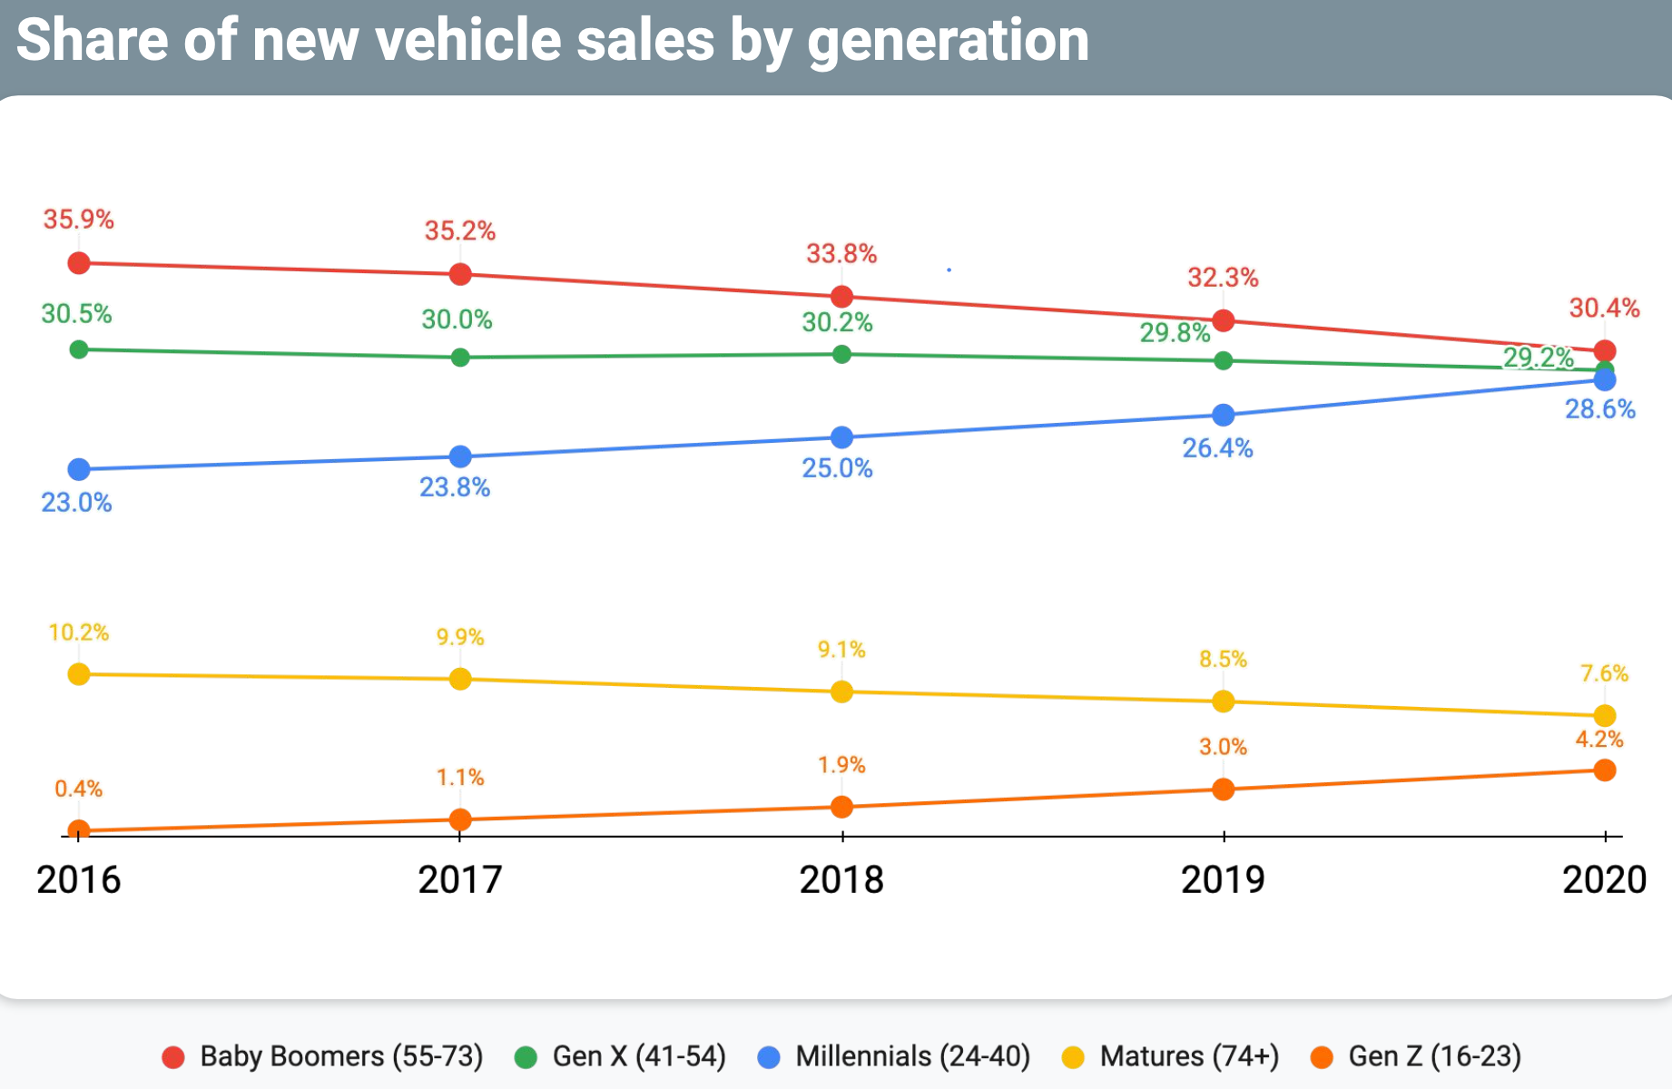
Millennials Trending to Be the Largest Buying Group
Notes:
Brand agnostic, tech savvy millennials trending to be the largest buying group in 2021 and beyond.
Consider 2x more brands than A55+
10x more likely to switch brands than A44+
41% more likely to be a cord cutter and stream on YouTube to a TV screen.
With these changes in consumer will come changes in behavior….

Slide 5
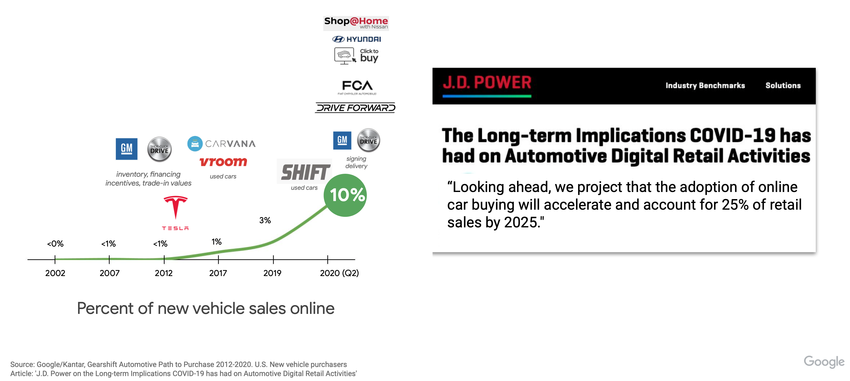
The Tipping Point in Automotive
Notes:
And with that said, our industry is approaching a tipping point…. Automotive went from 1% in 2017 to 10% in 2020. We care about this because it presents a change in dynamic in the way in which we sell cars and F&I products.
And we aren’t alone… another industry faced this tipping point. Raise your hand if you bought a new mattress in the last couple of years. What did you buy? The mattress industry is an $81B business that used to be 100% in showroom purchase. Not long ago, there were 2-3 main players in the space. Today, there are 175 online mattress brands that sell mattresses AND protection packages online.
-69% of recent mattress purchasers said they never visited a brick-and-mortar store
Just like other industries who have embraced this evolution, we too will find a way to maximize F&I revenue in an atmosphere where the customer may not be sitting directly in front of us. And we will do this by making it easy for them to do business with us on their terms.
Slide transition- this Tipping point has ignited a jump of activity from Big Tech and legislators regarding how we will market to these prospective buyers.

Slide 6
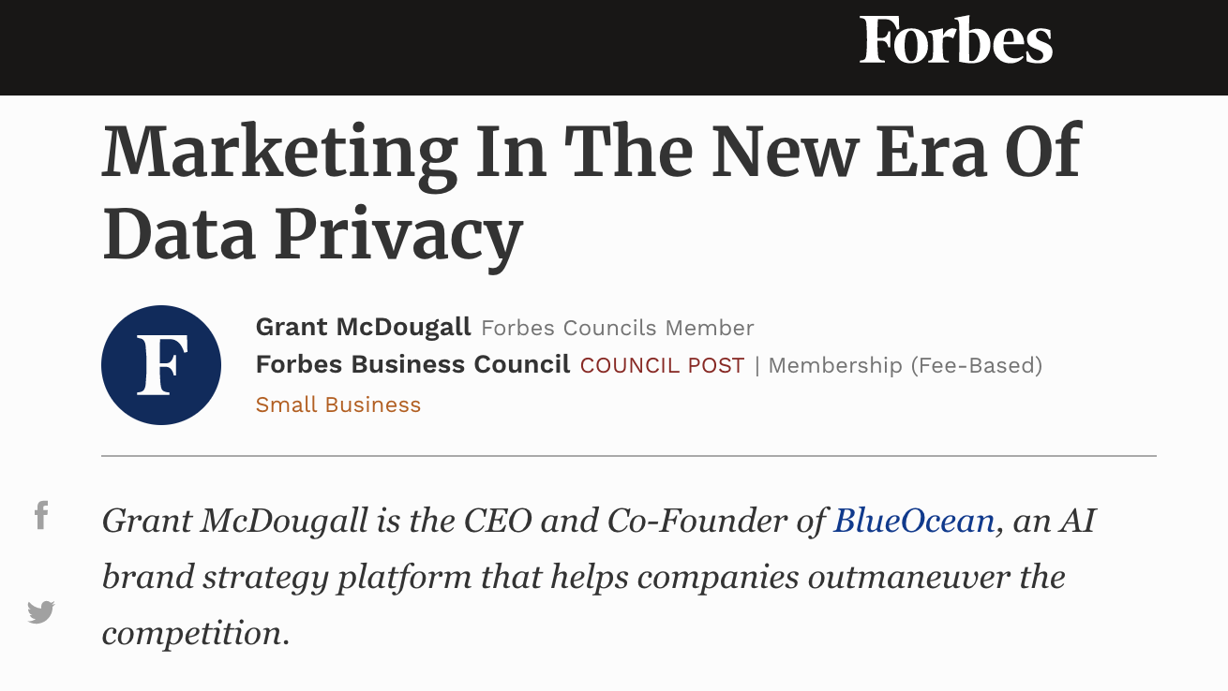


The Privacy Conversation
Source: GDPR, CCPA, Google, Meta (Facebook).
Notes:
We are all Marketers, whether we want to be or not. And while you don’t have to become a marketing privacy expert in the next few minutes, I would ask that you listen to the following with an open mind:
In 2016, The EU enacted the General Data Protection Regulation (GDRP), a move they deemed an “essential step to strengthen individuals’ fundamental rights in the digital age”.
Shortly after that, in 2018, California enacted the California Consumer Privacy Act (CCPA), cementing the right for consumers to know how their data is collected, used, and have the ability to delete or opt out.
Other states followed, and we today have an ever-evolving conversation around the way businesses can market to prospects in a compliant manner.
Now, all this legislation created a firestorm of activity from Big Tech, who doubled down on their investments in AI, Machine Learning, and privacy-first automation solutions to “model” data and allow dealerships to market to consumers in a compliant, sustainable manner. While this conversation is important, it begs the question: What about the customers already doing business with us?

Slide 7

Impacts to the Auto Industry
Marketing strategies will evolve
Risks for non-compliance
Notes:
To understand how this impacts us directly, let’s first define 1P data. 1P data means that you already have an existing business relationship with this person, they are not a “prospect”.
Marketing strategies will evolve. Please consider the impact here as we have gone from 1% ORT to 10% in less than 2 years. As the pendulum swings more toward ORT, your approach, whether you are an agent, F&I manager, or a Marketing will evolve and marketing will play a big role in your success. Dealers will continue to face strict laws regarding how they market to prospective shoppers. For example, Google recently worked with the US Dept of HUD to implement restrictions on businesses that deal w/ employment, housing, or credit (i.e. auto), from targeting shoppers based on gender, age, parental status, marital status, or zip code. This is a significant change from tactics previously used by marketers for decades. Instead, dealers will leverage technology in a privacy safe way to market to prospects w/out these specific identifiers.
The risks here for non-compliance can’t be understated. If you are working with a partner that promotes “workarounds” or “fingerprinting” you may end up breaking the law.

Slide 8
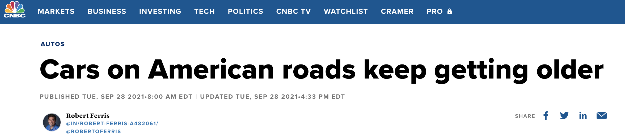
How do we thrive in this changing ecosystem?
Prioritize 1P data
Stay current on privacy laws
Elevate the conversation
Notes:
With unprecedented inventory levels, we must look elsewhere to generate growth. The Service drive is an excellent starting place. Per IHS, the # of vehicles on the road today (284M) and the average age of a vehicle on the road today is 12.1 years, which is an all-time record. This means that your customers are at risk of coming out of pocket for major repairs. 33% of adults surveyed cannot afford a $500-$600 vehicle repair bill / 60% would have difficulty covering a $1,000 repair bill.
You can reach out to these customers and help them get into a VSC, which will improve your Sales & Service retention, protect your customer, and drive incremental revenue in F&I and Service.
Dealers often pay thousands of dollars to “data providers” for their magic lists or targeting capabilities, yet often miss the most important, most profitable customers, the ones sitting right under our nose (in other words, there 1P data). Because they are considered “1P data”, they are not truly the focal point of the previously discussed privacy legislation. Net/net, you own this customer relationship, you are free to market directly to them, and should prioritize them over all others.

Slide 9
Questions We Should Ask
How are our clients going to market their first-party data?
Who are my partners on this journey, and have they been vetted?
What technologies are we leveraging to meet the customer on their terms?
Notes:
So here are some questions we can ask ourselves.
How often are we talking to our customers? Are we doing so in a meaningful, personal way?
Who are my partners? Are we at risk?
And what tech are we using?
CLOSING STORY ABOUT TRAVELING ACROSS COUNTRY W/ NO WALLET
MY NAME IS TONY CARROLL AND I’M PROUD TO WORK AT iA AMERICAN WARRANTY GROUP where we are investing in the future, focusing on innovation, and being your long term partner in this journey. Thank you.

Slide 10
tony.carroll@iaawg.com

Slide 11
Q&A

